Slide 1
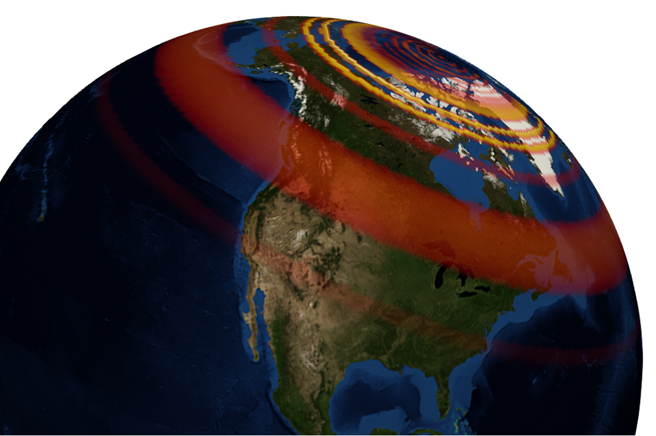
GEOL593: Seismology and Earth Structure, Spring 2023
Lecture 1: Seismic waves
1/17/23
Ross Maguire
rossrm@illinois.edu
3014 NHB

Slide 2
Course Objectives
Gain understanding of how Earth models are constrained from seismic data
Learn practical skills in seismic data analysis, including how to access public seismic data repositories and apply processing techniques used in seismology research
Identify important areas of future seismological research and how it relates to other fields
Learning outcomes
Basic competency in python programming and data analysis
Creating “publication quality” figures, including maps of geospatial data
Understand machine learning applications in seismology with practical experience using models capable of earthquake detection
Communicating research in the form of a short “AGU-style” talk

Slide 3
Logistics
Meeting Time/ Location
Tuesday & Thursday, 9:30 AM – 10:50 AM
G17 Foreign Languages Building
Textbook
Foundations of Modern Global Seismology, Ammon 2020 (eBook available at UIUC library)
Office Hours: M & W 10:00 am – 11:00 am, or by appointment; 3014 NHB or virtually on Zoom
rossrm@Illinois.edu
Course Material
https://gitlab.com/rmaguire/geol_593
Course Credit:
80%: Computer lab assignments
20%: Research paper presentation
Grading Policy
A+ (97 – 100%); A (93 – 96%); A- (90 – 92%)
B+ (87 – 89%); B (83 – 86%); B- (80 – 82%)
C+ (77 – 79%); C (73 – 76%); C- (70 – 72%)
D (60 – 69%); F (less than 60%)

Slide 4
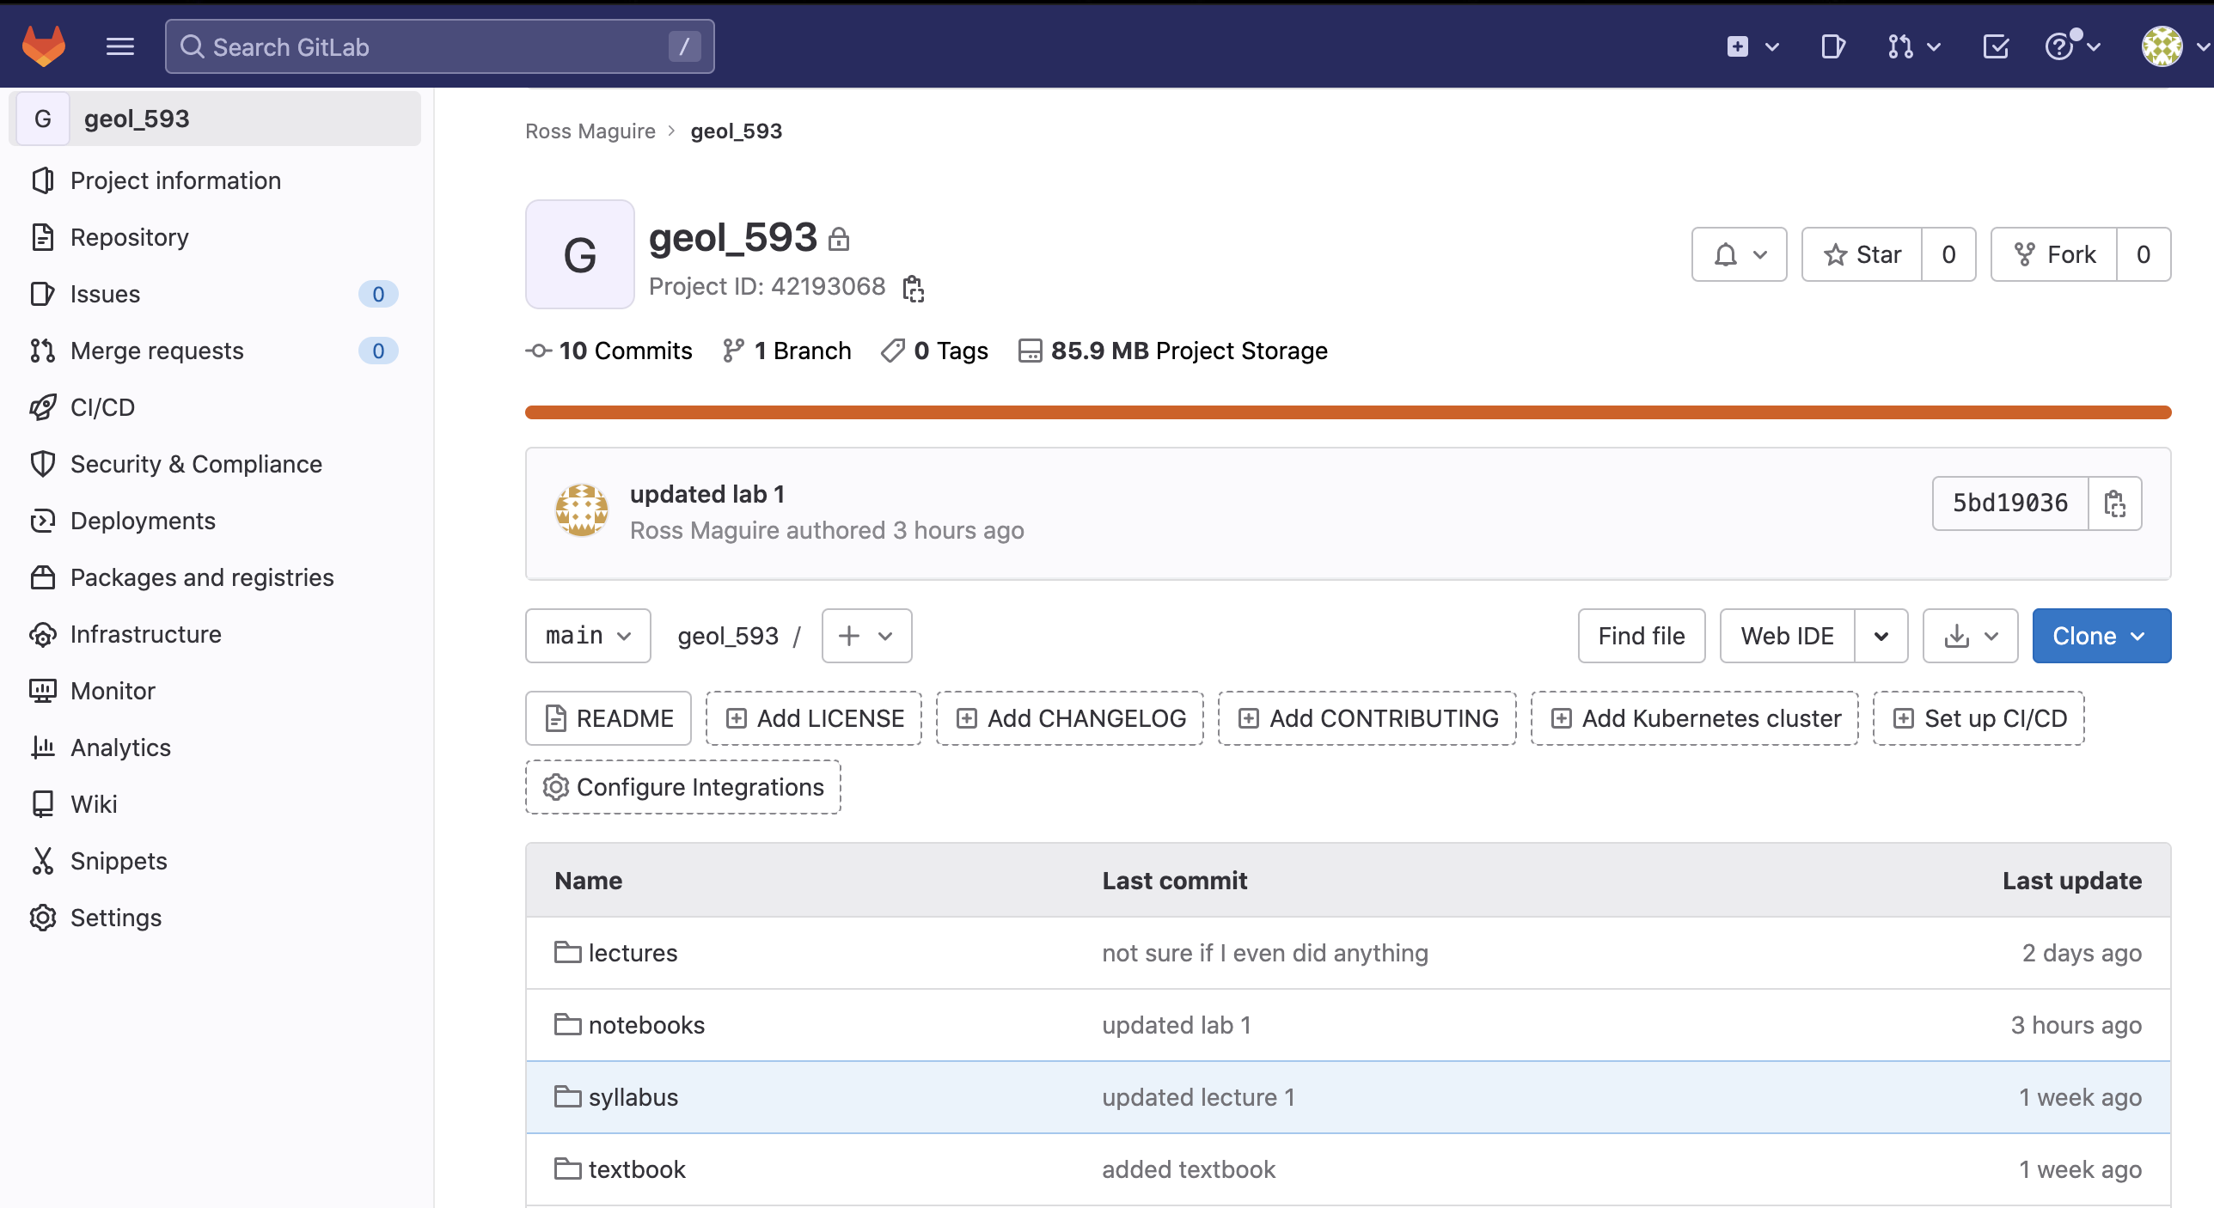
Accessing course material: https://gitlab.com/rmaguire/geol_593

Slide 5
Class schedule
 | Dates | Topic | Lab assignment
Week 1: | Jan 17, Jan 19 | Course overview/ Seismic waves | Lab 1: Python crash course
Week 2: | Jan 24, Jan 26 | Seismic signal processing | Lab 2: Introduction to Obspy
Week 3: | Jan 31, Feb 2 | Moment Tensors/ Inverse methods | Lab 3: Moment tensor inversion
Week 4: | Feb 7, Feb 9 | Seismic wave propagation 1 | Lab 4: Reference Earth models: The “1D” Earth
Week 5: | Feb 14, Feb 16 | Seismic wave propagation 2 | Lab 5: Seismic tomography
Week 6: | Feb 21, Feb 23 | Normal modes: Free oscillations of Earth | Lab 6: Surface waves and normal modes
Week 7: | Feb 28, Mar 2 | Imaging Earth Structure 1: Seismic tomography | Lab 7: Receiver functions
Week 8: | Mar 7, Mar 9 | Imaging Earth Structure 2: Seismic discontinuities | Research paper discussion
Week 9: | Mar 14, Mar 16 | Spring break
Week 10: | Mar 21, Mar 23 | Anisotropy and anelasticity | Lab 8. Shear wave splitting
Week 11: | Mar 28, Mar 30 | Planetary seismology 1 | Lab 9: InSight- Seismology on Mars
Week 12: | Apr 4, Apr 6 | Planetary seismology 2 | Finish Lab 9
Week 13: | Apr 11, Apr 13 | Machine learning in seismology 1 | Lab 10: Earthquake detection with machine learning
Week 14: | Apr 18, Apr 20 | Machine learning in seismology 2 | Finish Lab 10
Week 15: | Apr 25, Apr 27 | Frontiers of seismology: What’s next? | Work on presentations
Week 16: | May 2, May 4 | Research paper presentations
*schedule may be subject to change

Slide 6
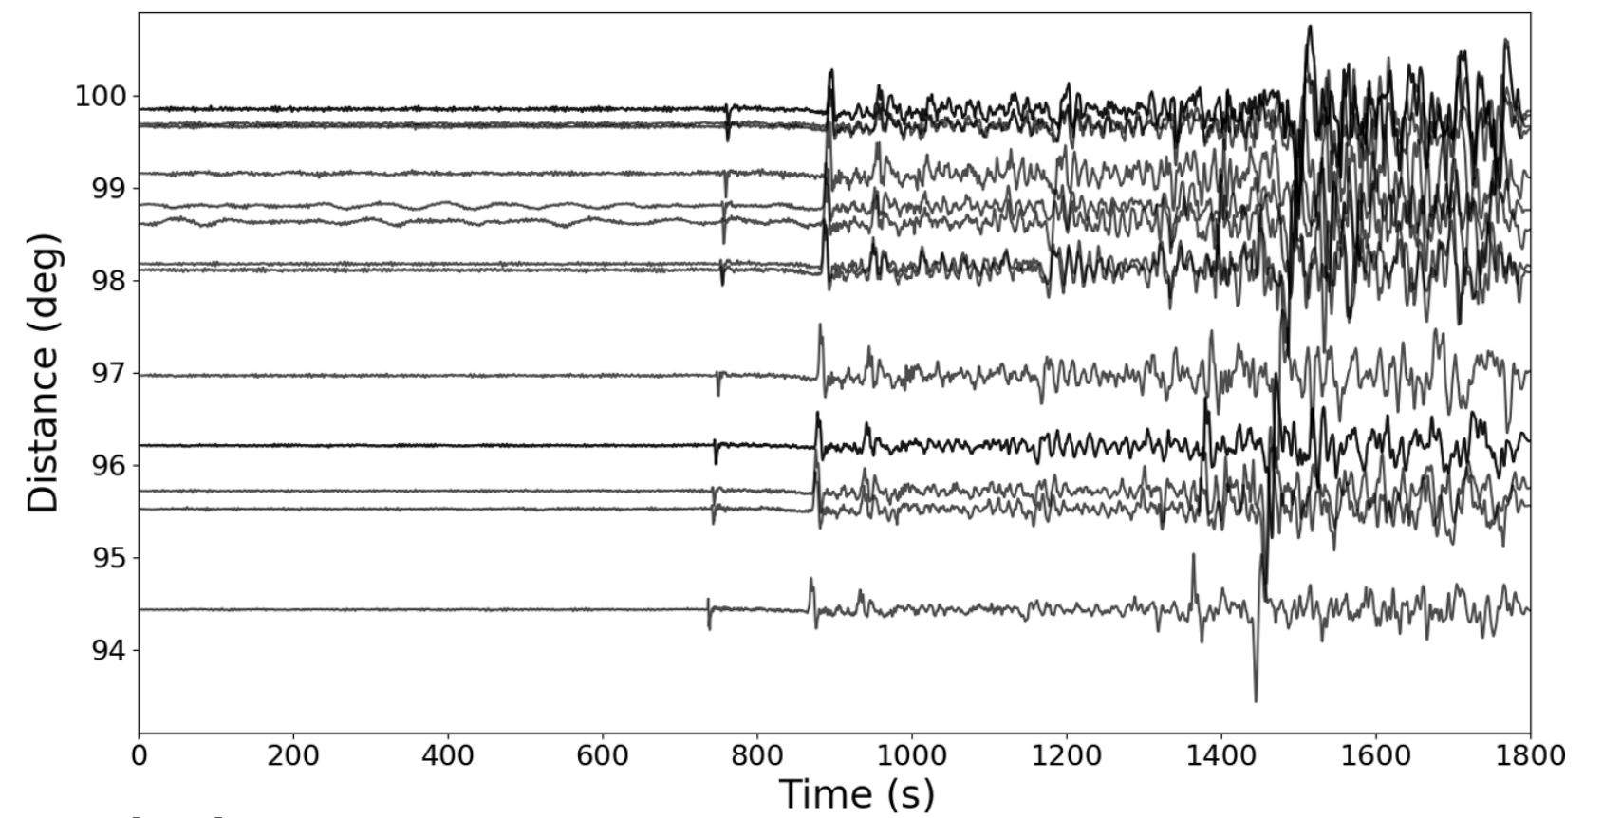
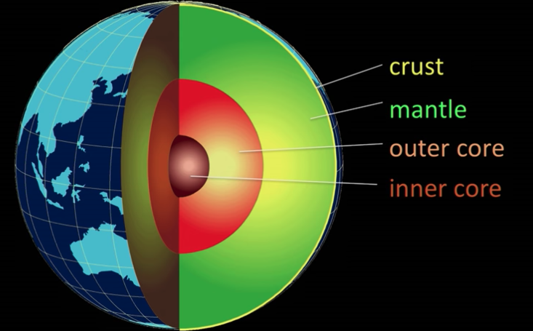
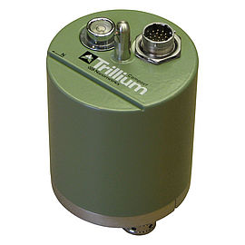
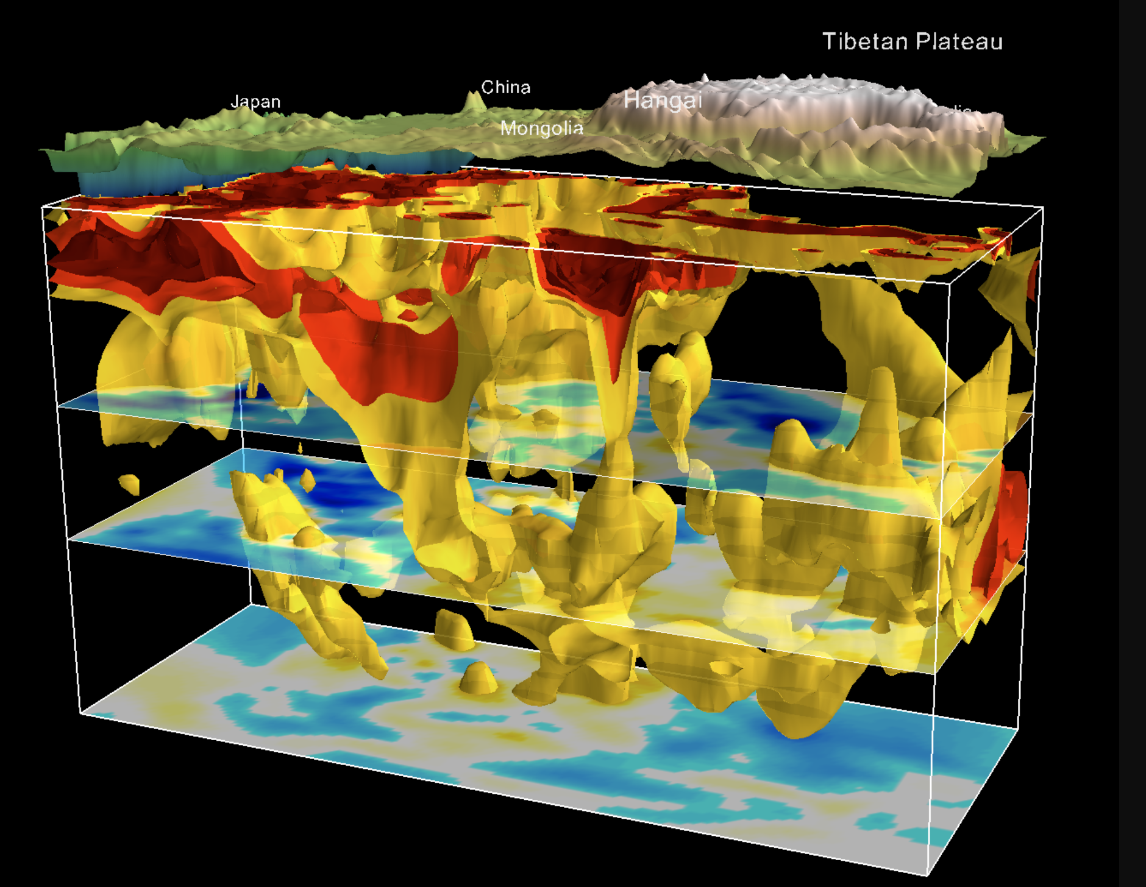
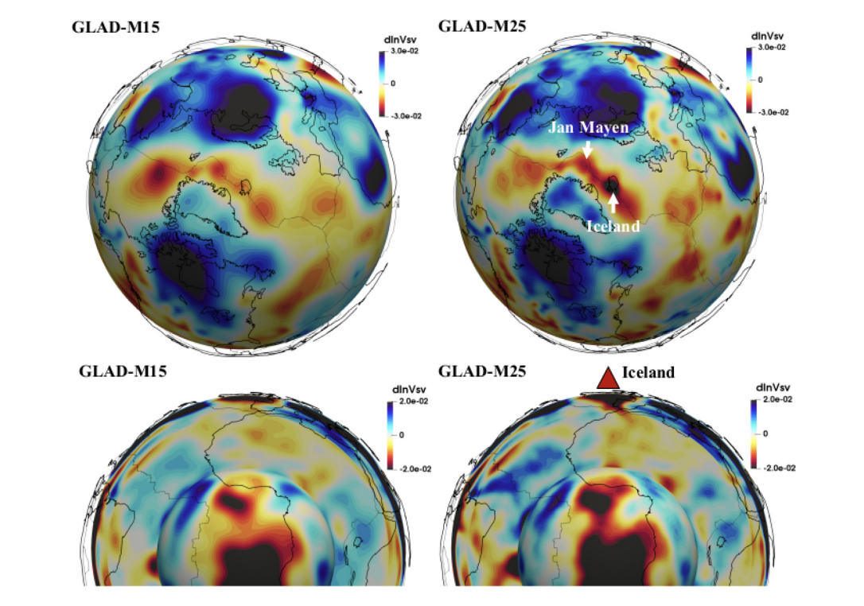
i) Seismic data
ii) The layered Earth
Hosseini et al. 2017
iii) The 3D heterogeneous Earth
Chen et al. 2014
Bozdag et al. 2016

Slide 7
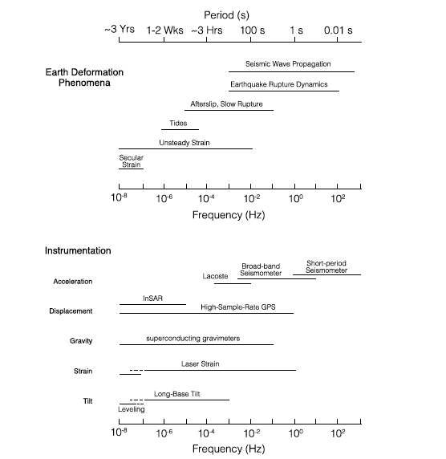
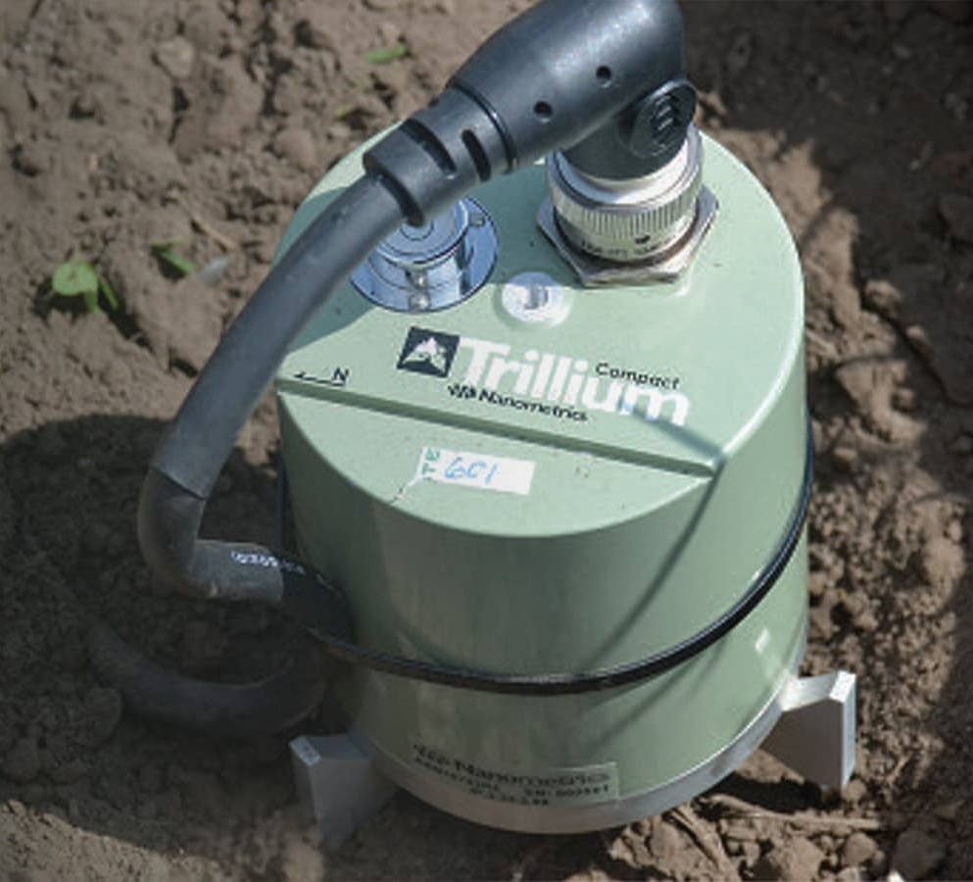
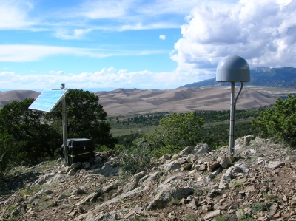
Timescales of Earth deformation

Slide 8
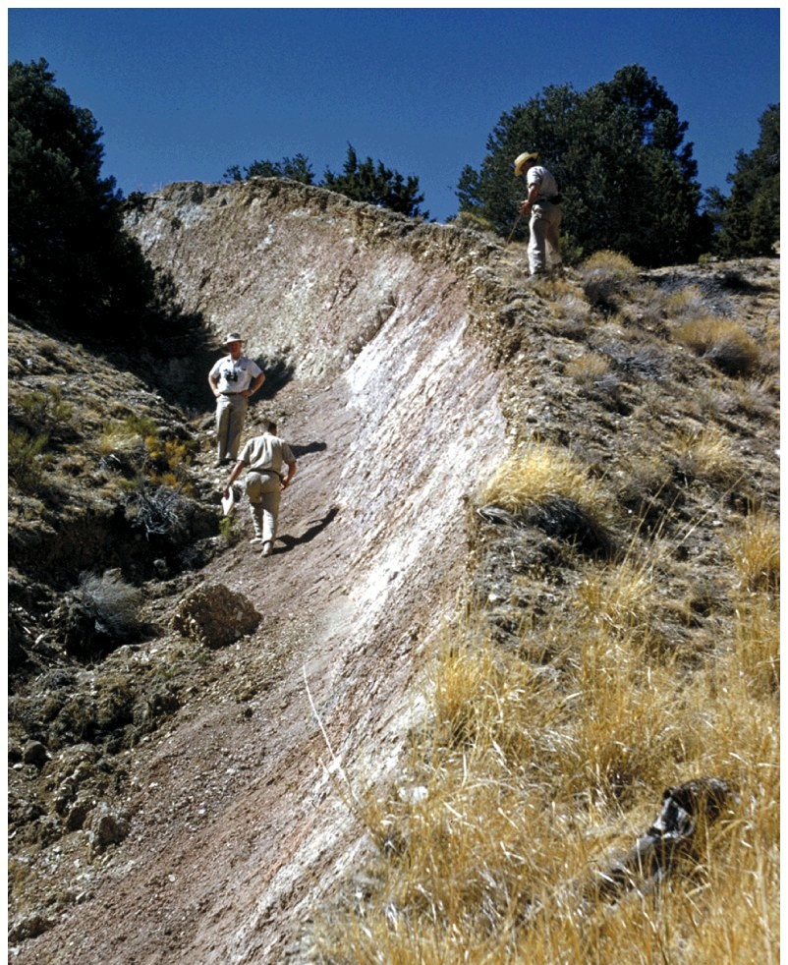
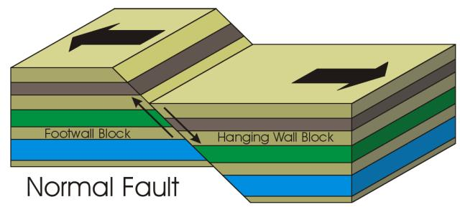
What is an earthquake?
Tectonic earthquakes
Tectonic earthquakes involve frictional sliding along a planar surface. Earthquakes occur when stress on the fault plane exceeds the frictional strength of the fault plane contact.

Slide 9
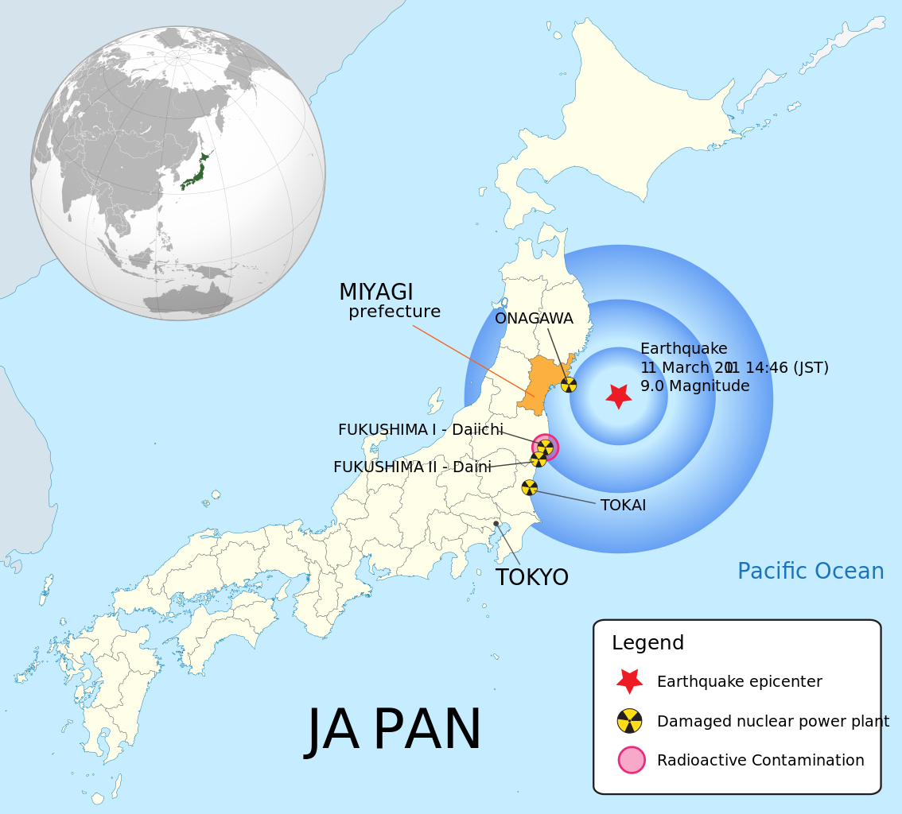
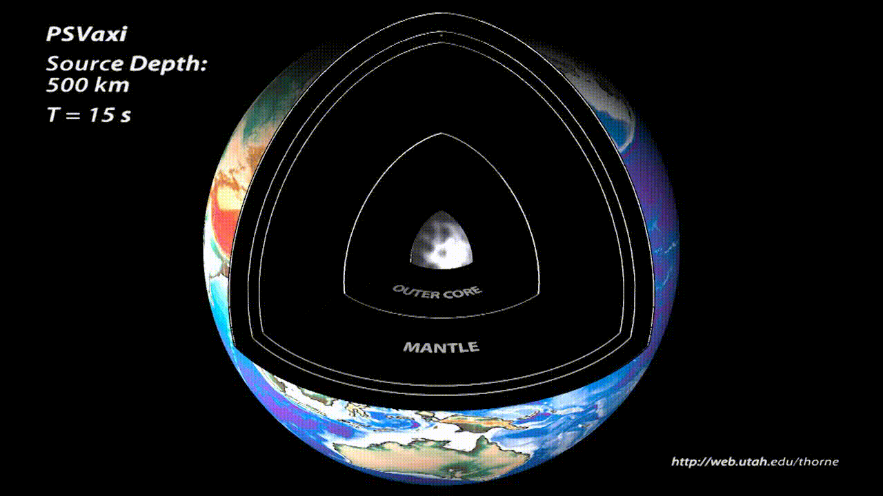
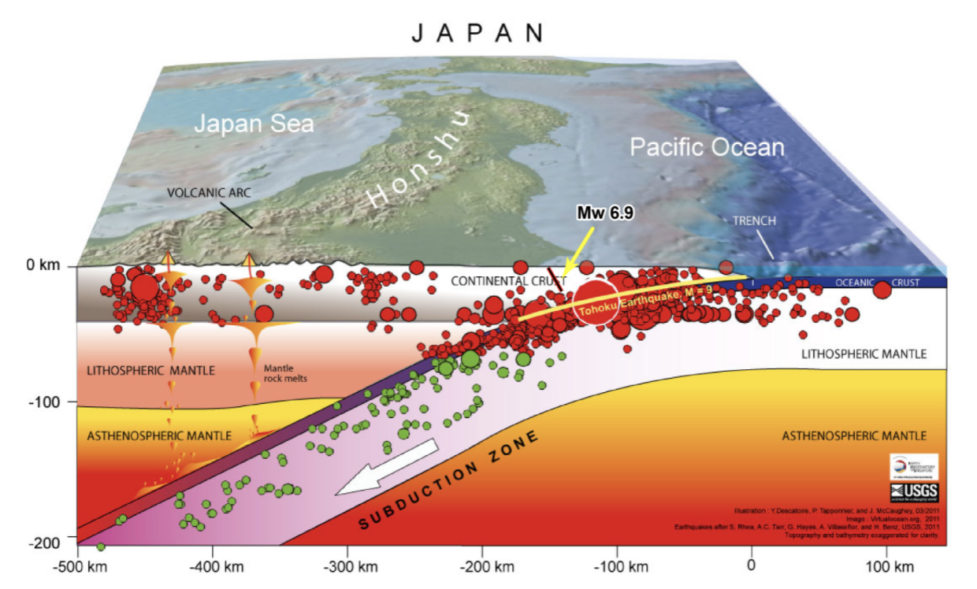
Global wave propagation
Mw 9.0 Tohoku-Oki Earthquake,
March 11, 2011

Slide 10
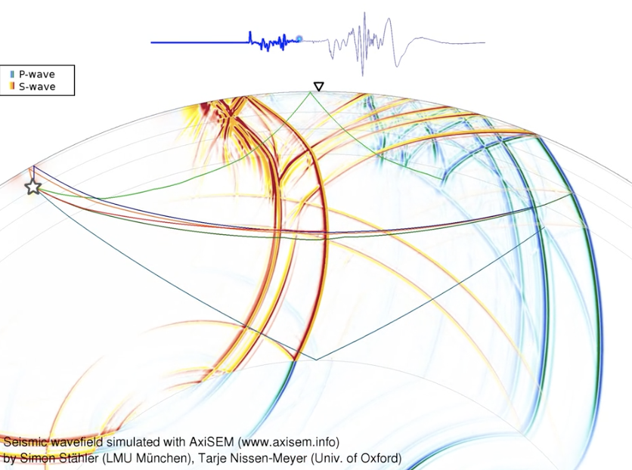
Global wave propagation
Surface waves
Body waves

Slide 11
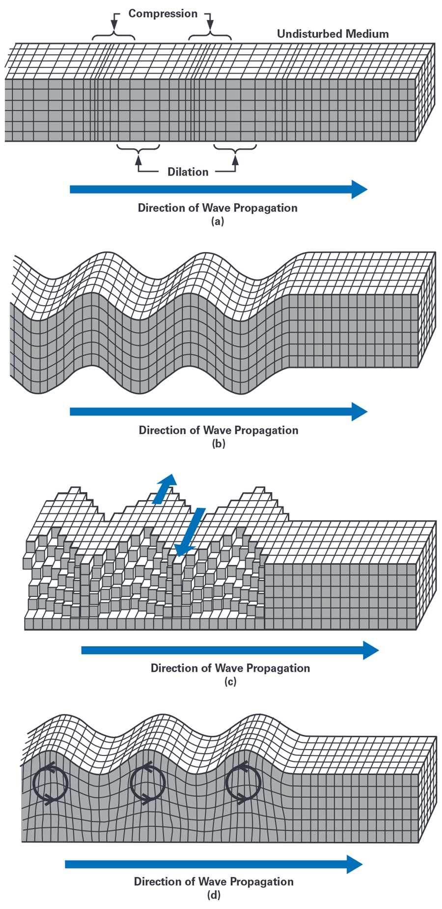
Types of seismic waves
P waves
Love waves
S waves
Rayleigh waves
wavelength

Slide 12
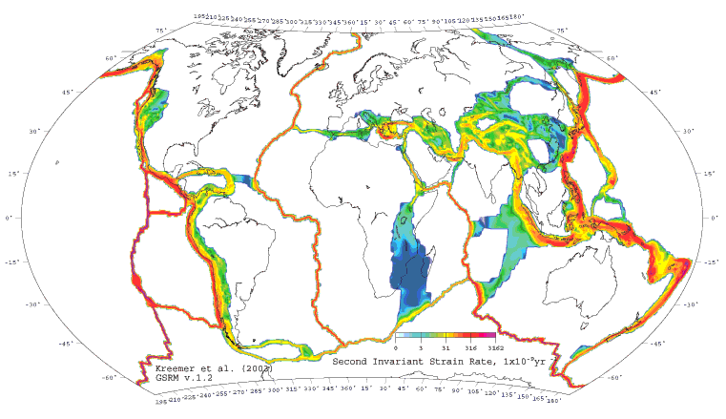
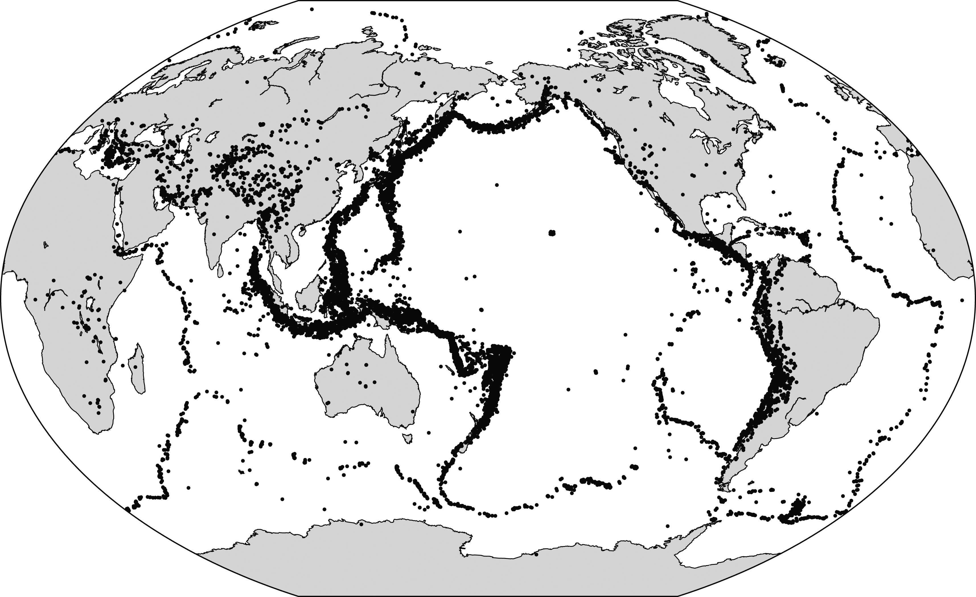
Distribution of seismicity
UNAVCO
Shearer, 2009

Slide 13
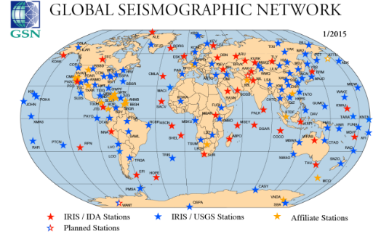
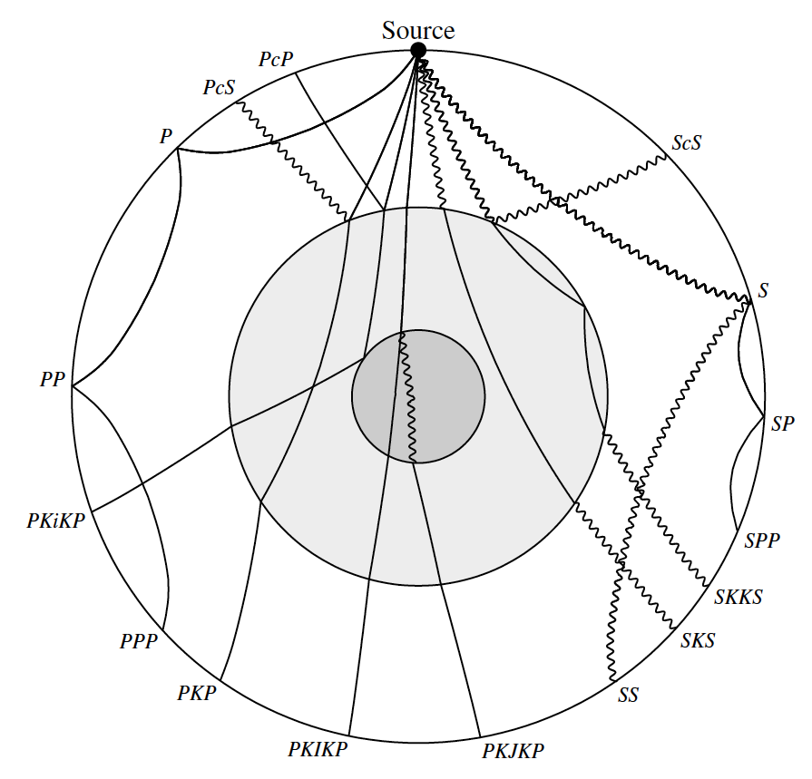
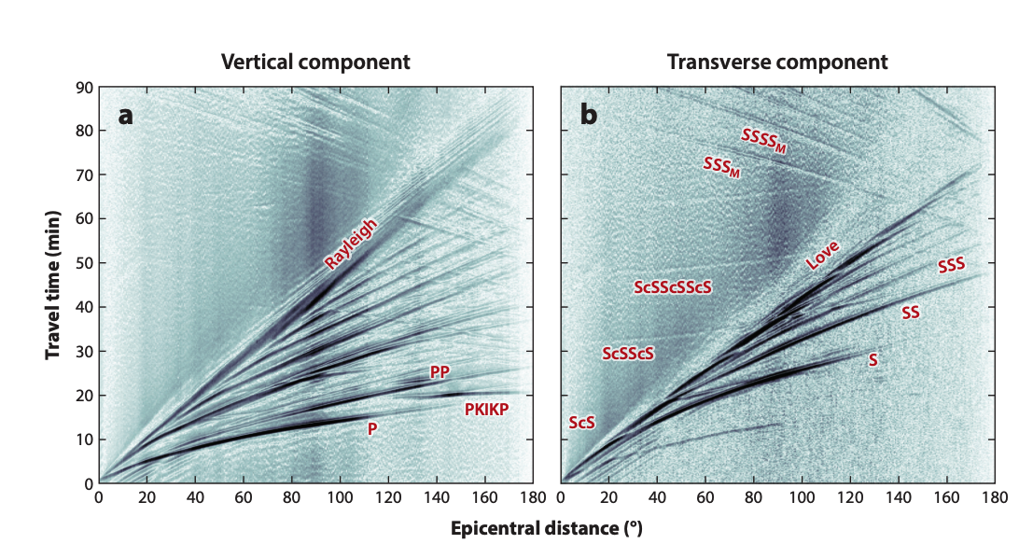
Global seismic observations
Ritsema and Lekic, 2020

Slide 14

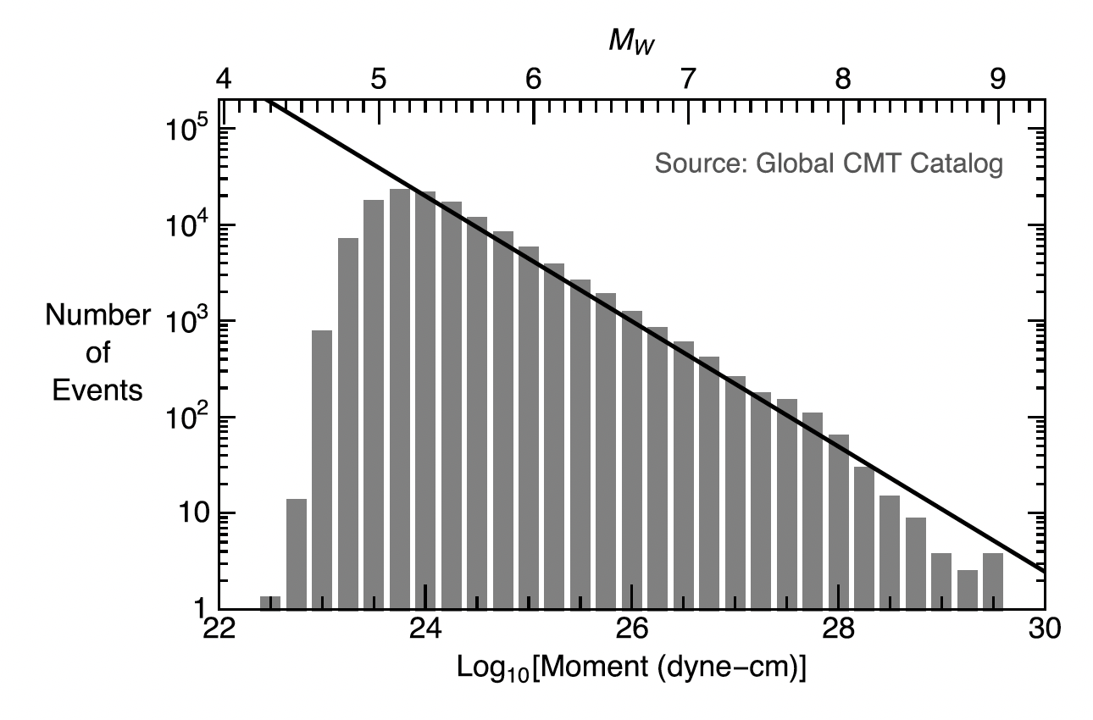
Gutenberg-Richter relationship
*Rule of thumb: For every unit magnitude increase,
the annual number of earthquakes decreases by a
factor of 10
b is ~ 1 for tectonic earthquakes
Higher b-values indicate more small events relative to large events
Spatiotemporal variations of b-value can give insight into earthquake fault properties

Slide 15
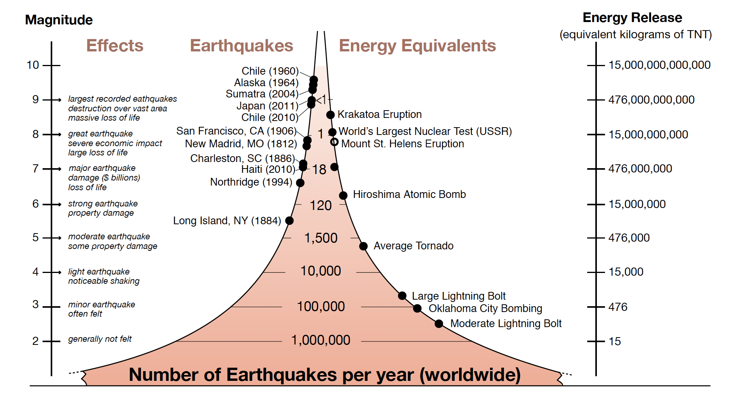
Energy released by earthquakes
Source: IRIS

Slide 16
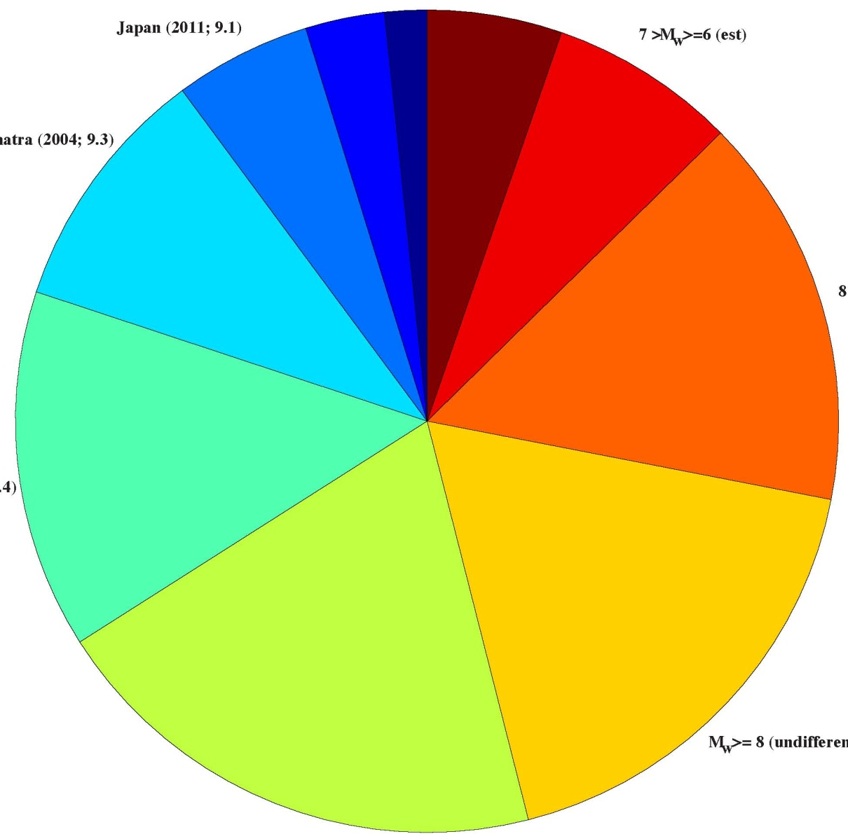
Largest earthquakes in the last century
Earthquake
Chile, 1960, Mw 9.5
Alaska, 1964, Mw 9.2
Northern Sumatra , 2004, Mw 9.0
Japan, 2011, Mw 9.0
Kamchatka, 1952, Mw 9.0
Chile, 2010, Mw 9.0
Off the Coast of Ecuador, 1906, Mw 8.8
Northern Sumatra, 2005, Mw 8.7
Rat Islands, Alaska, 1965, Mw 8.7
Andreanof Islands, Alaska, 1957, Mw 8.6
Assam – Tibet, 1950, Mw 8.6
11. Kuril Islands, 1963, Mw 8.5
12. Banda Sea, Indonesia, 1938, Mw 8.5
13. Kamchatka, 1923, Mw 8.5
Kamchatka 1952
M5 to M6
Japan 2011
M6 to M7
Sumatra 2004
M7 to M8
Earthquake
“moment”
Alaska 1964
The five M9 earthquakes from the past century account for more than 50% of the total energy release by all earthquakes
Chile 1960
M8 to M9

Slide 17
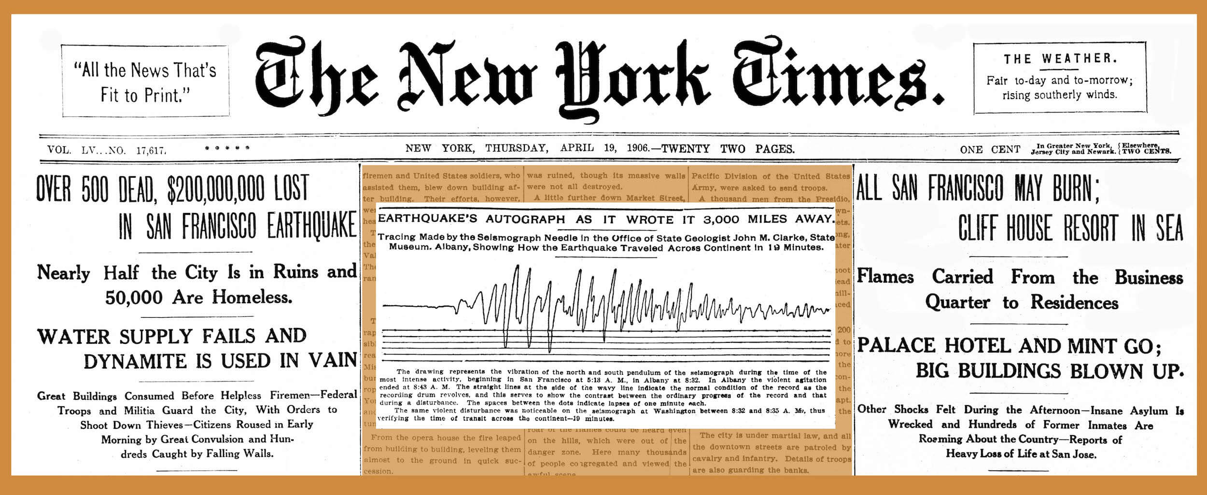
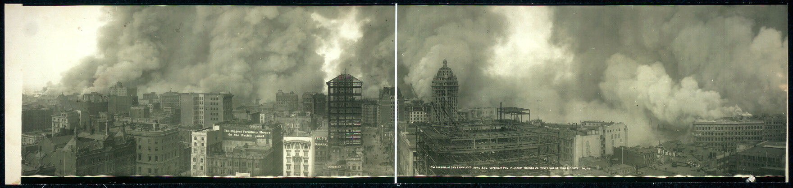
1906 San Francisco earthquake
Estimated moment magnitude Mw 7.9
Deadliest earthquake in US history (at least 700 killed)
Ruptured large portion (> 400 km) of San Andreas fault

Slide 18
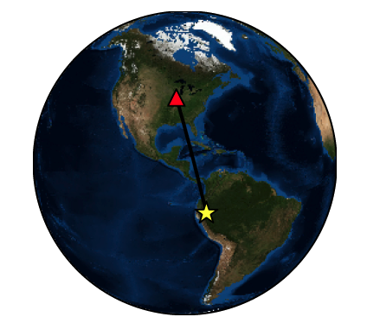
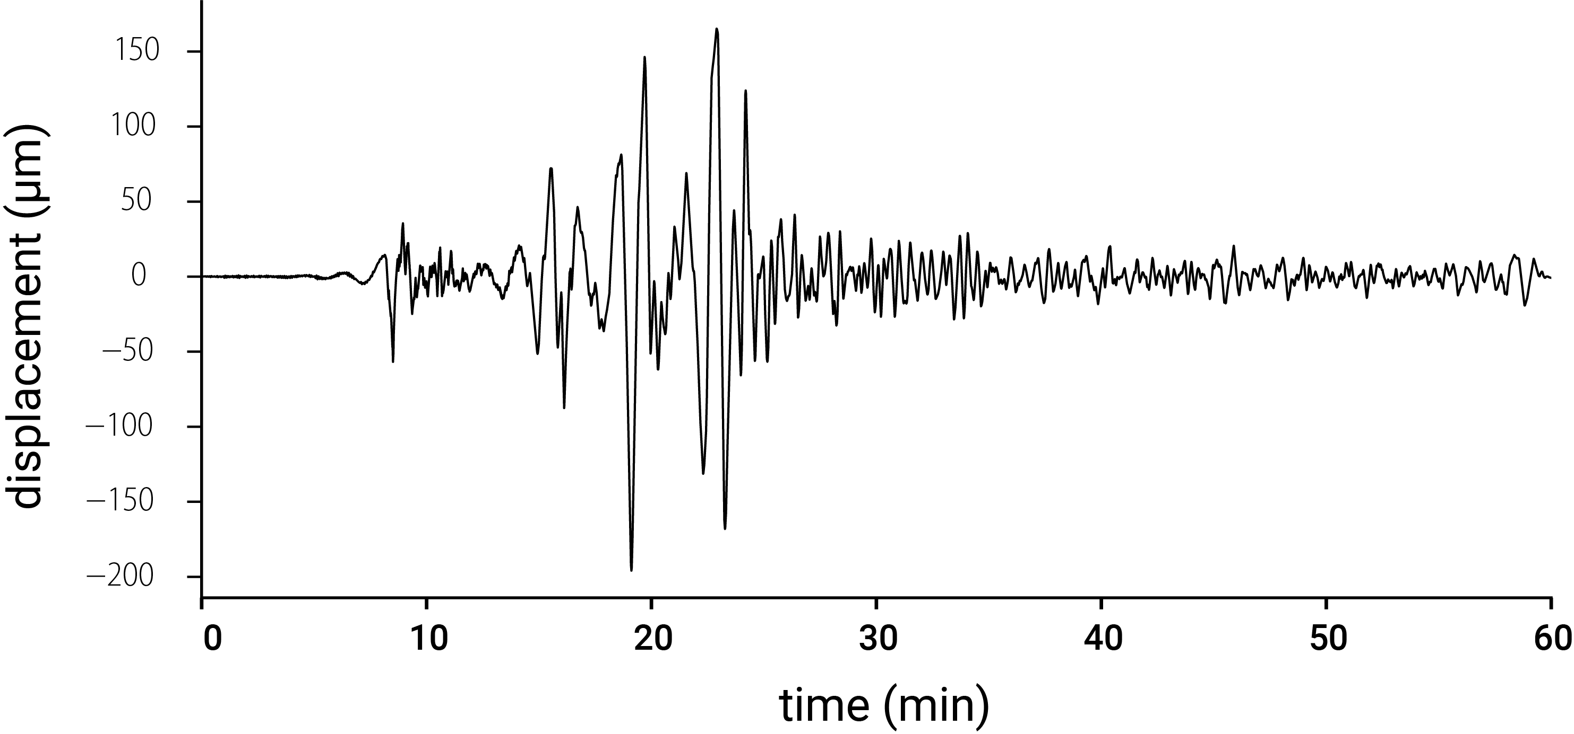
Mw 7.5, N. Peru, 2021-11-28
Recorded at station US.HDIL, Bloomington IL
Epicentral distance = 46.3º
Back azimuth = 162.7º
Event depth = 112.5 km
Rayleigh
S
P

Slide 19
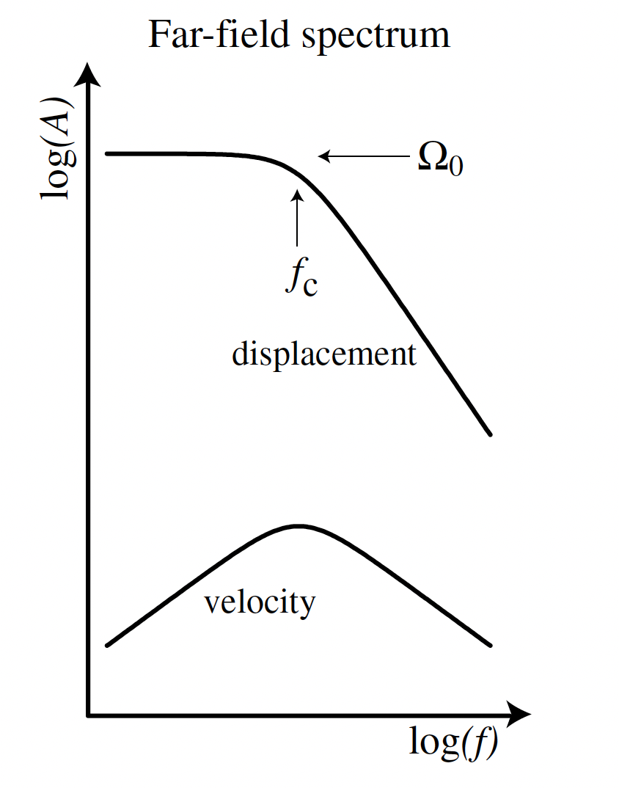
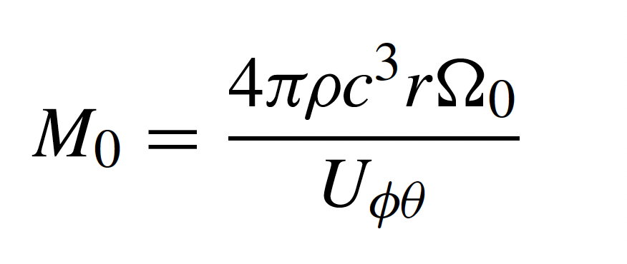

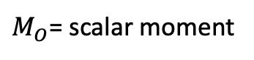



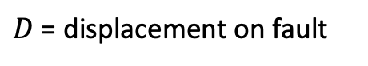
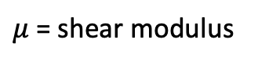
Earthquake magnitude scales
Moment magnitude scale
$$M_{O}= μDA$$
$M_{O}$= scalar moment
$μ$ = shear modulus
$D$ = displacement on fault
$A$ = area of fault that ruptured
$$M_{w}=\frac{2}{3}\log\left(M_{O}\right)−6.07$$
Units of $M_{O}$ N*m
wave speed
distance from source
density
radiation pattern term

Slide 20
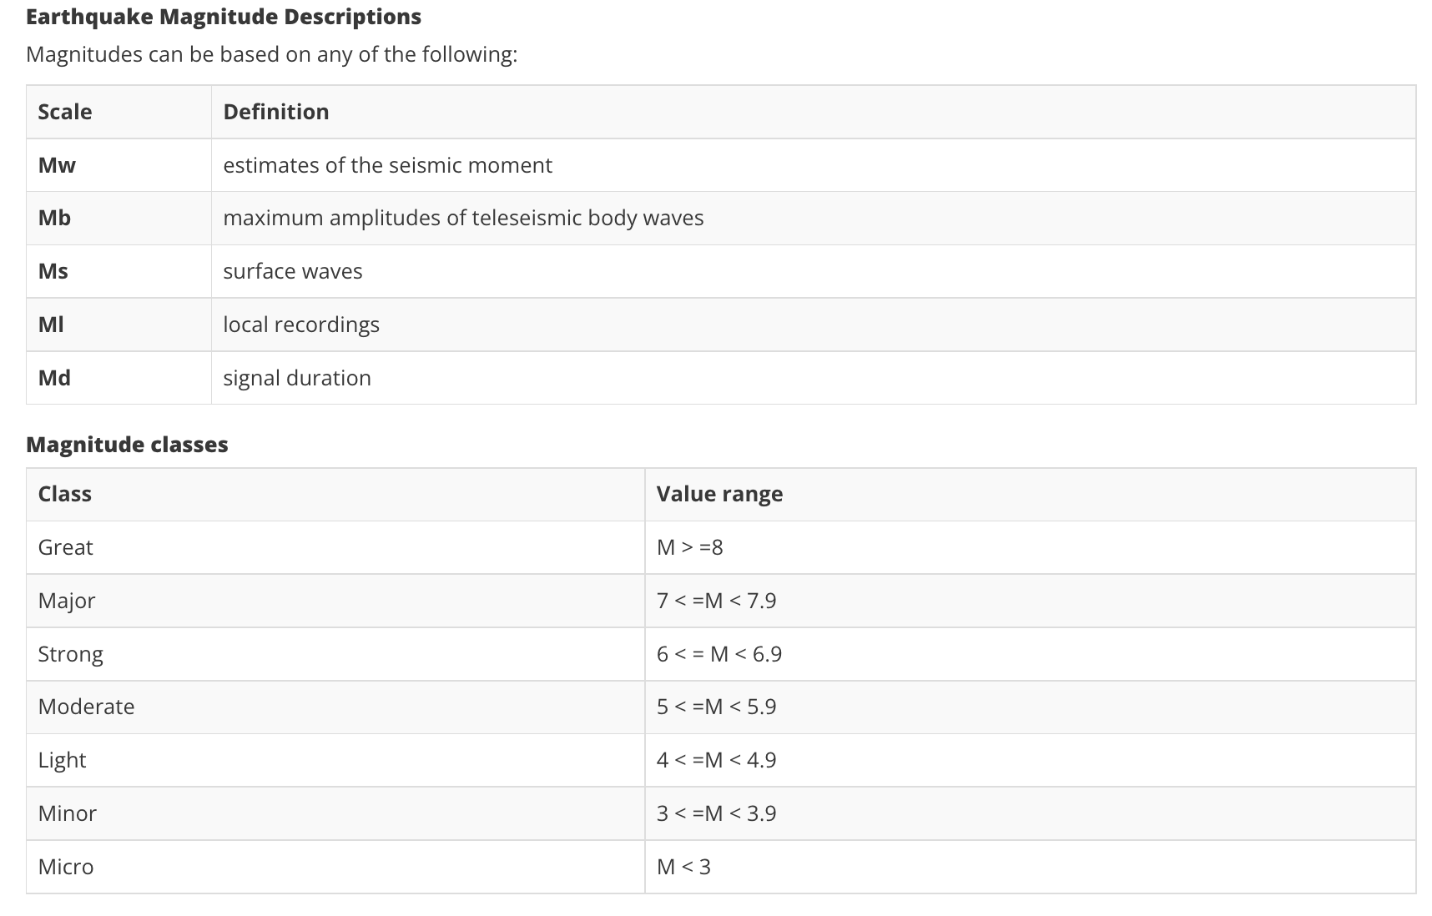
Earthquake magnitude scales
Source: IRIS

Slide 21
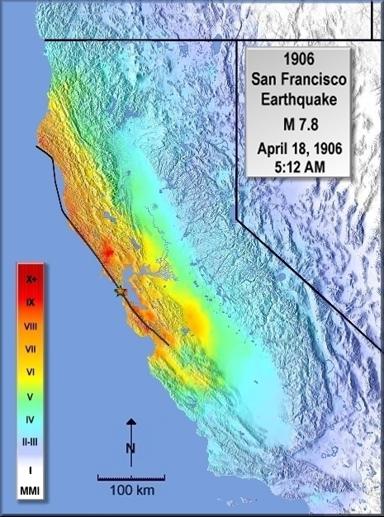
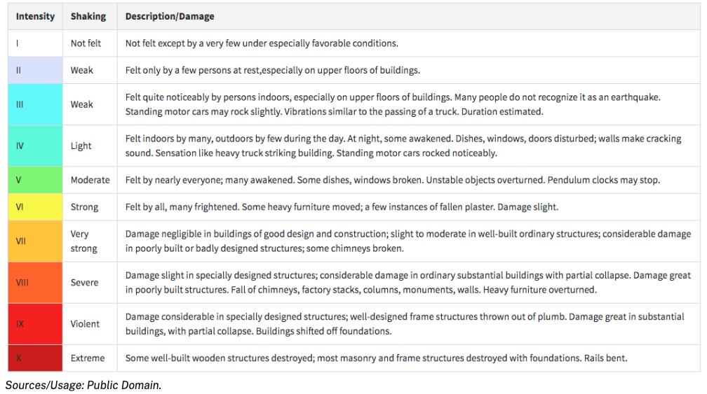
Earthquake magnitude scales
Modified Mercalli scale
Not designed to measure energy released by earthquake.

Slide 22
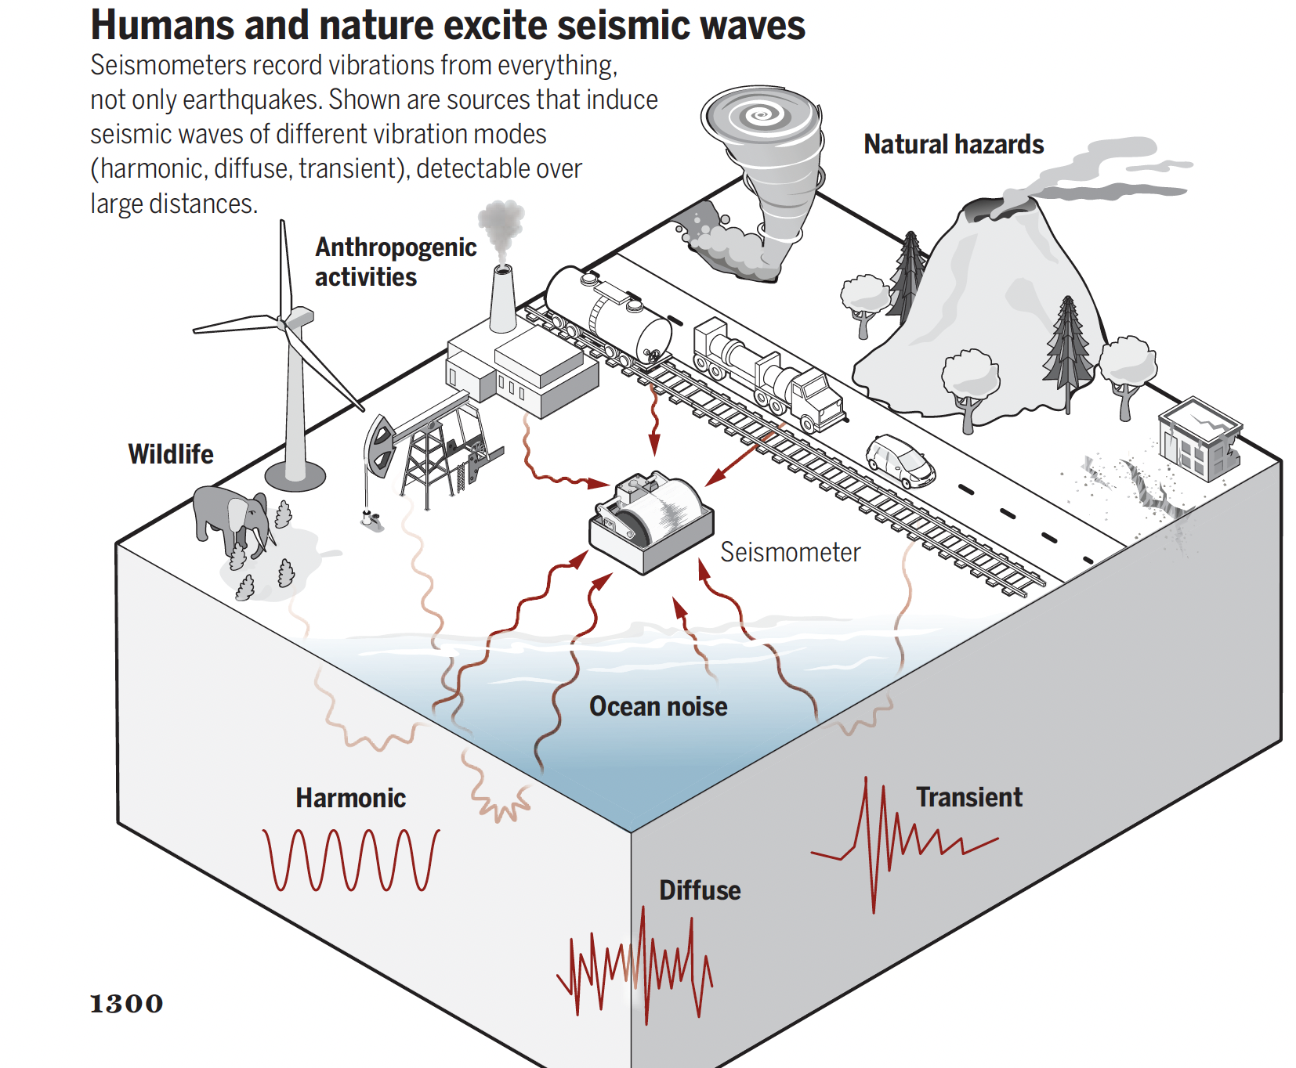
Sources of seismic energy
Denolle & Nissen-Meyer 2020

Slide 23
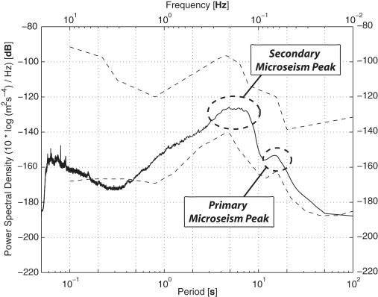
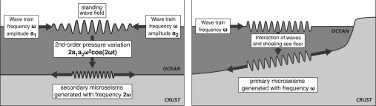
Background ‘noise’
Noise model of Peterson, 1993
Primary “microseism”: 10 – 16 s, waves interacting with shore
Secondary microseism: 4 – 10 s, wave interference patterns
Ebeling, 2012

Slide 24
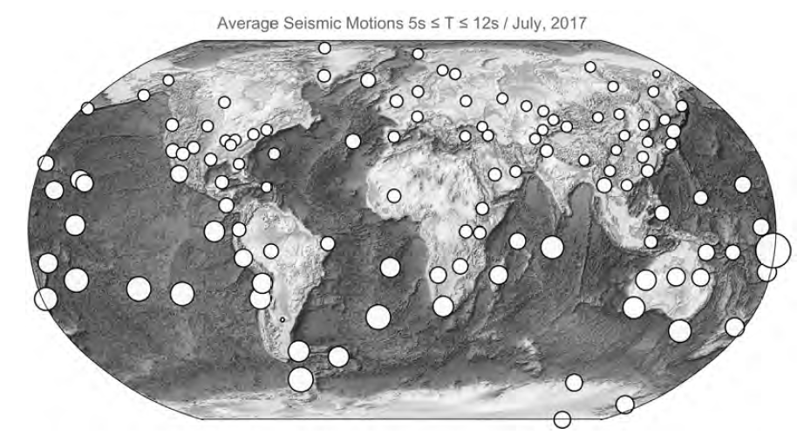
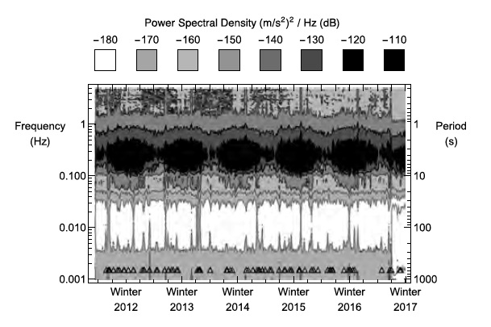
Seasonal variations in background noise
Spectral density of background noise for a station in central Pennsylvania (SSPA)

Slide 25
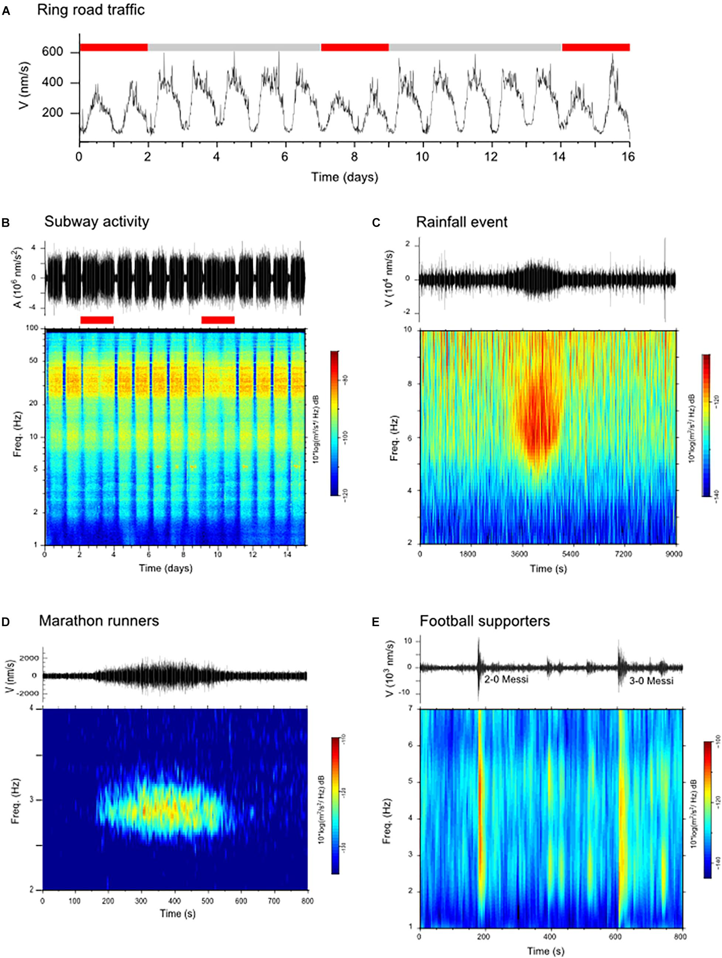
Anthropogenic seismic noise
Anthropogenic noise sources:
Cars/Trains
Construction
Walking/Running
Concerts
Sporting events
Diaz et al., 2020

Slide 26
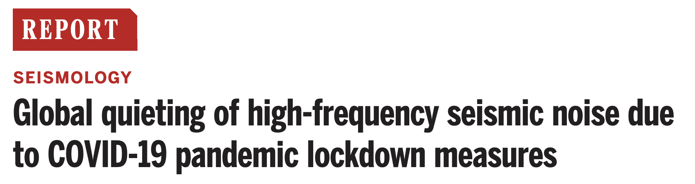
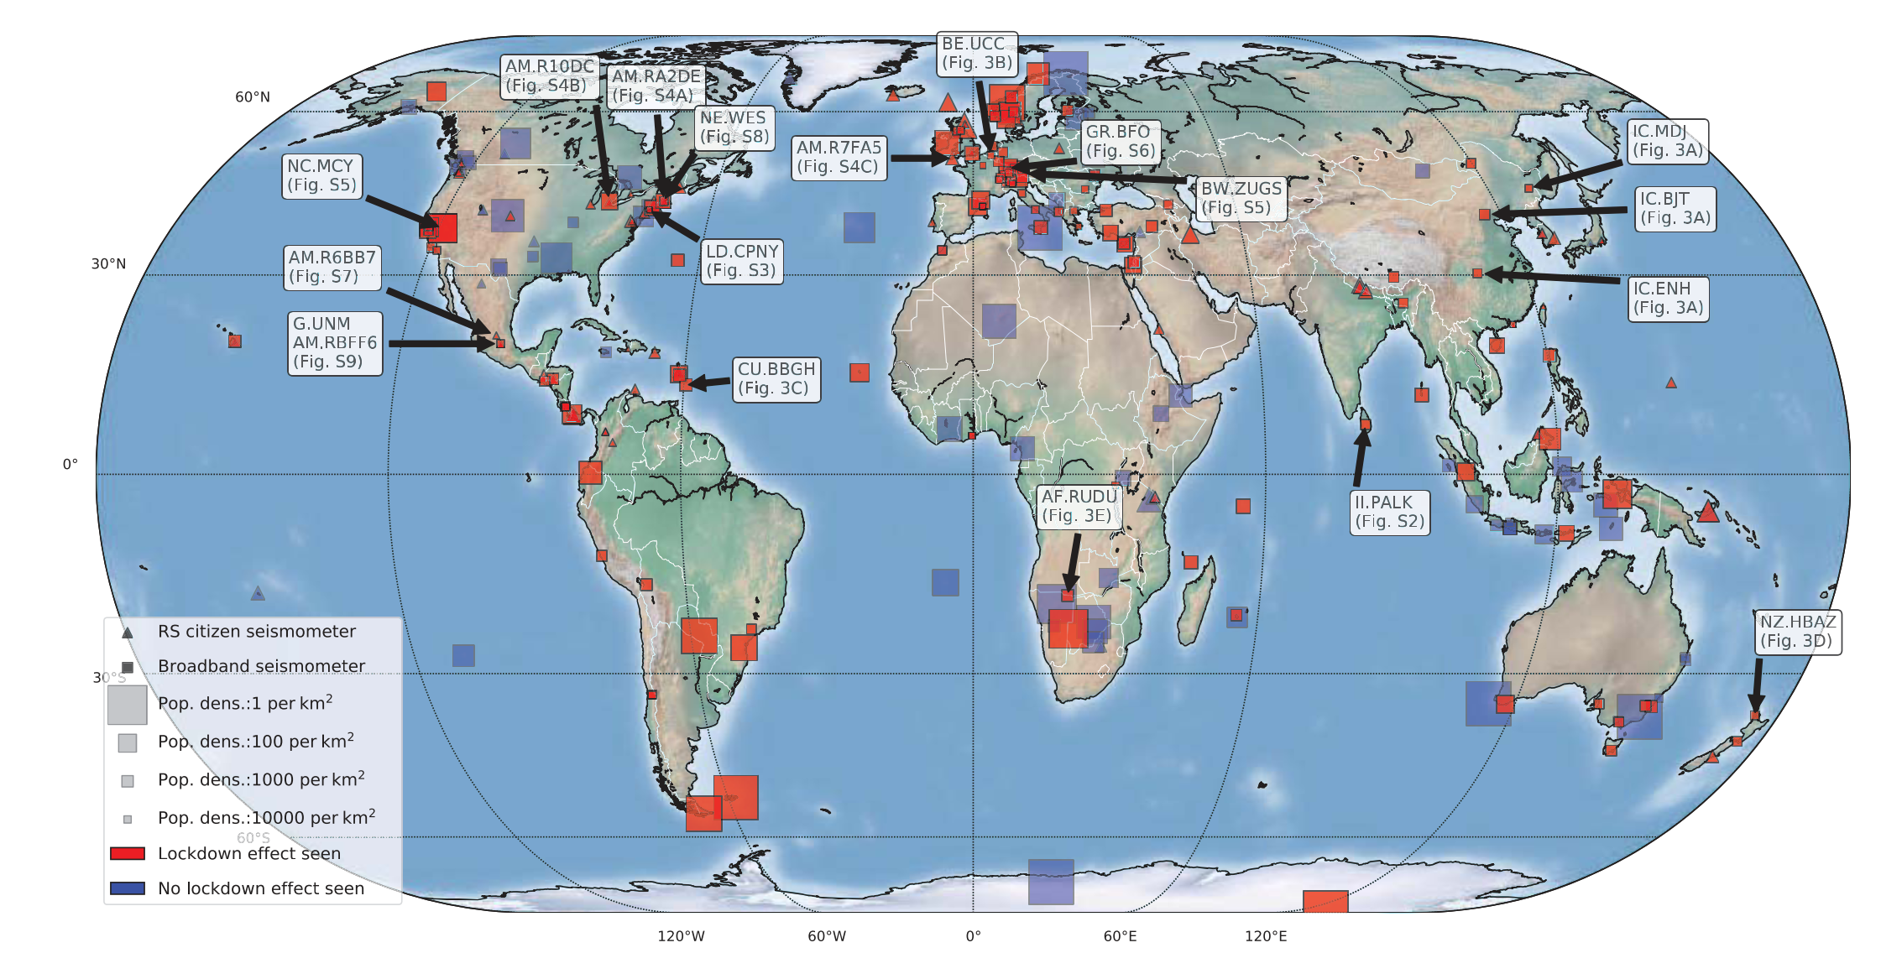
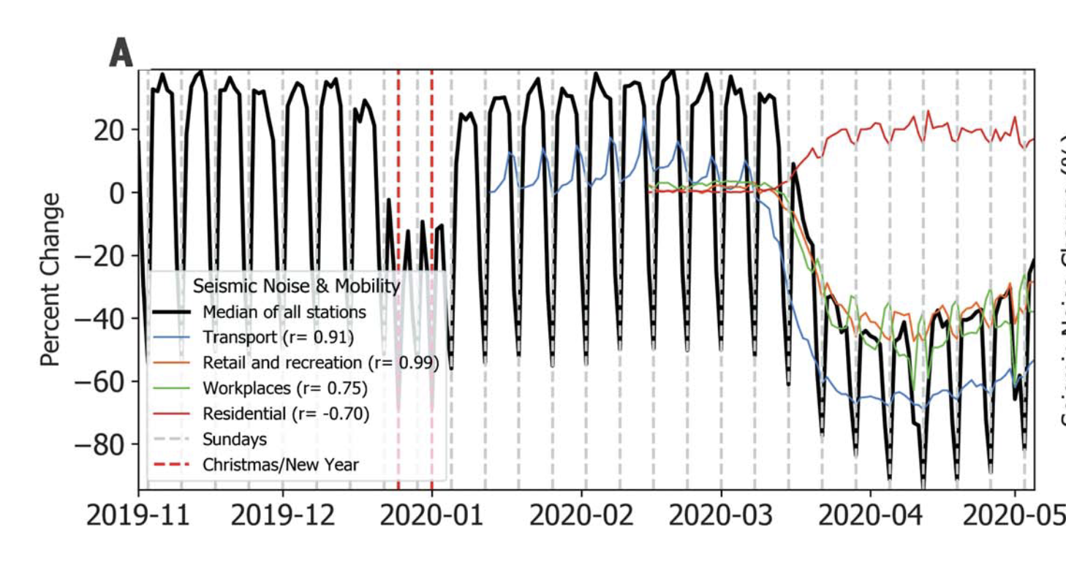
Amplitude of 4 – 14 Hz band dramatically reduced during lockdown

Slide 27
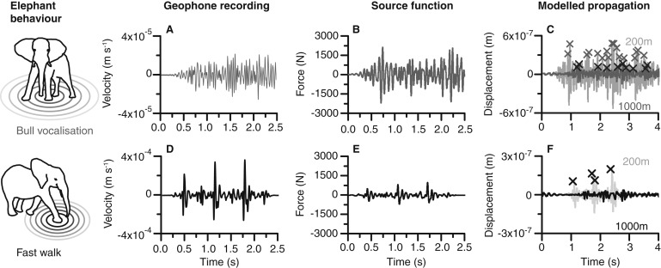
Elephant seismology
Mortimer et al., (2018)

Slide 28
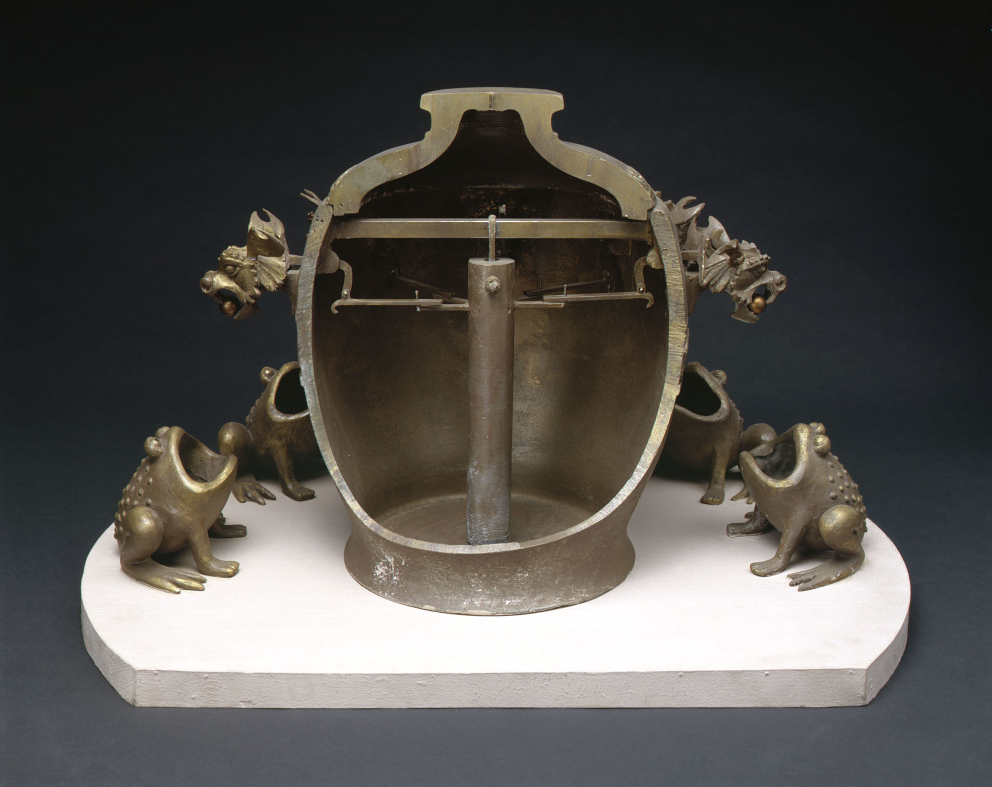
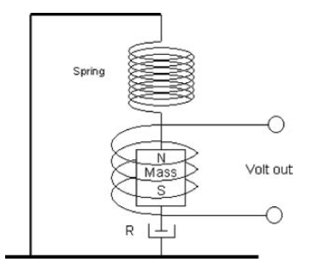
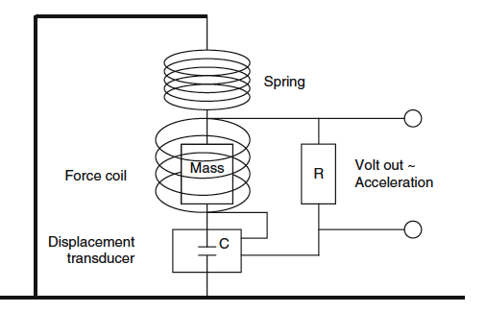
Recording ground motion
Replica “seismoscope” (Zhang Heng, 132 AD)
Simplest seismometers are essentially pendulums
Modern instruments record voltage that is proportional to the ground motion (usually velocity)

Slide 29



Seismometers
http://seismo.berkeley.edu/~rallen/images/
http://nanometrics.ca
https://www.passcal.nmt.edu/content/instrumentation/all-one-systems/nodes

Slide 30


Slide 31

First lab assignment

